Slide 1
Amey Subhash Lakeshri Email: amey.lakeshri@in.ey.com Contact: +91 9892632393 Linkedin: linkedin.com/in/amey-subhash-lakeshri-321211107
2023

Slide 2
Profile
Amey Subhash Lakeshri Mr. Amey Subhash Lakeshri is the Associate Director of Cyber Forensic Technology and Discovery Services at Ernst & Young LLP. He has executed large scale cyber security, privacy, ransomware investigations, and compliance projects.
He has been awarded as:
“Emerging digital leader of the year 2023”
“Cybersecurity Champion 2023”
“Innovative CISO 2023”
“Top CISO 2023”
“Global CIO 200”
“ Innovative CISO 2023”
“ Innovative Cyber Leader of the year”
“Cyber Warrior 2022”
“ Outstanding Cyber Security Professional of the year”
“Cyber Sentinel 2022”
“Data Center Champion”
“Cyber Spartan 2021 India”
“Cyber Spartan 2020 India”
“Covid19 Superhero CIO 2020”
“Infosec Cyber Sentinel 2019”
“Infosec Award 2018”
In various Infosec events of India and Global
“Exceptional Entrepreneur” by EY Forensics 2022
“Most Promising Talent of the Year 2015” Zycus
“Monthly/Quarterly Appreciation/Awards”
In Organizations Served and to be continued
A strategist and implementer with recognised proficiency in spearheading business to accomplish corporate security goals successfully. He has more than 13 years of experience in the areas of Cyber Security, Data Privacy, Compliance, Risk Management, Governance, Network Security, Security Audits, Security Strategy, and Business Development.
Amey has led knowledge sharing sessions/webinars in India and around the world for more than 500 people at a time on topics such as Cyber Security, Cyber Forensics, Ransomware and Mitigation Approach, Data Privacy, How to Enable Business Securely, and so on. In addition, an ISACA Chennai KSS Session on Cyber was held, Moderator in Security Symposium
Cover Page Presence on leading Cyber Magazine 2022
Upcoming: Part of multiple Panels in Cyber Events and CISO Round Tables
He has completed his B.E. in ExTC, with post graduation in MIM, along with various security certifications such as ISO 27001:2013, PCI DSS, CCNP, Pursing CIPM, CISM etc.

Slide 3
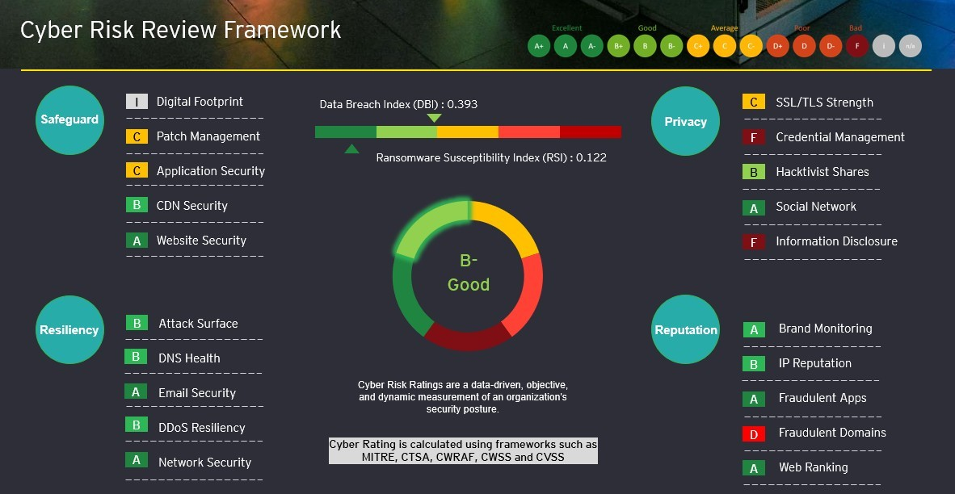
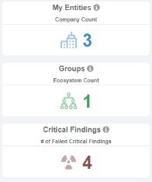
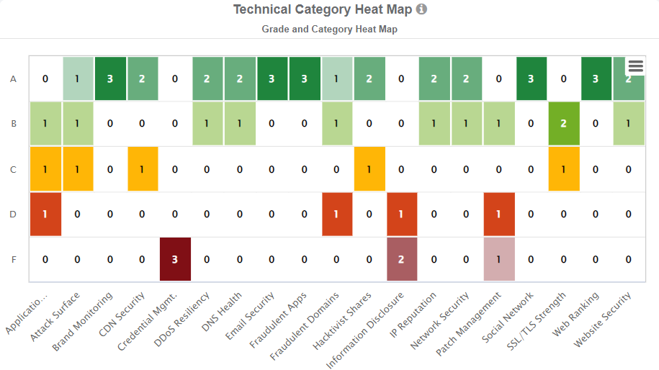
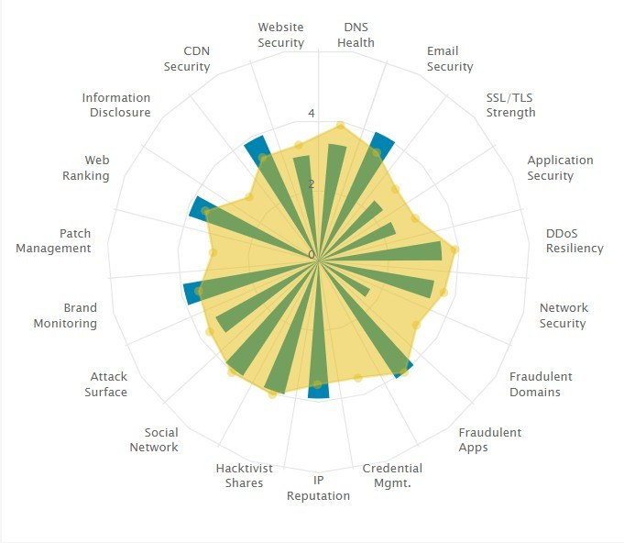
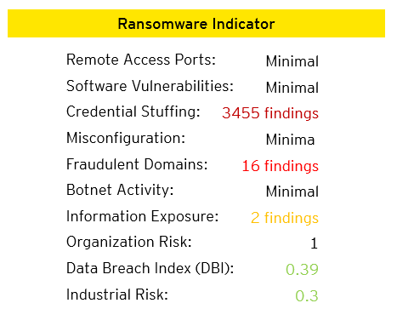
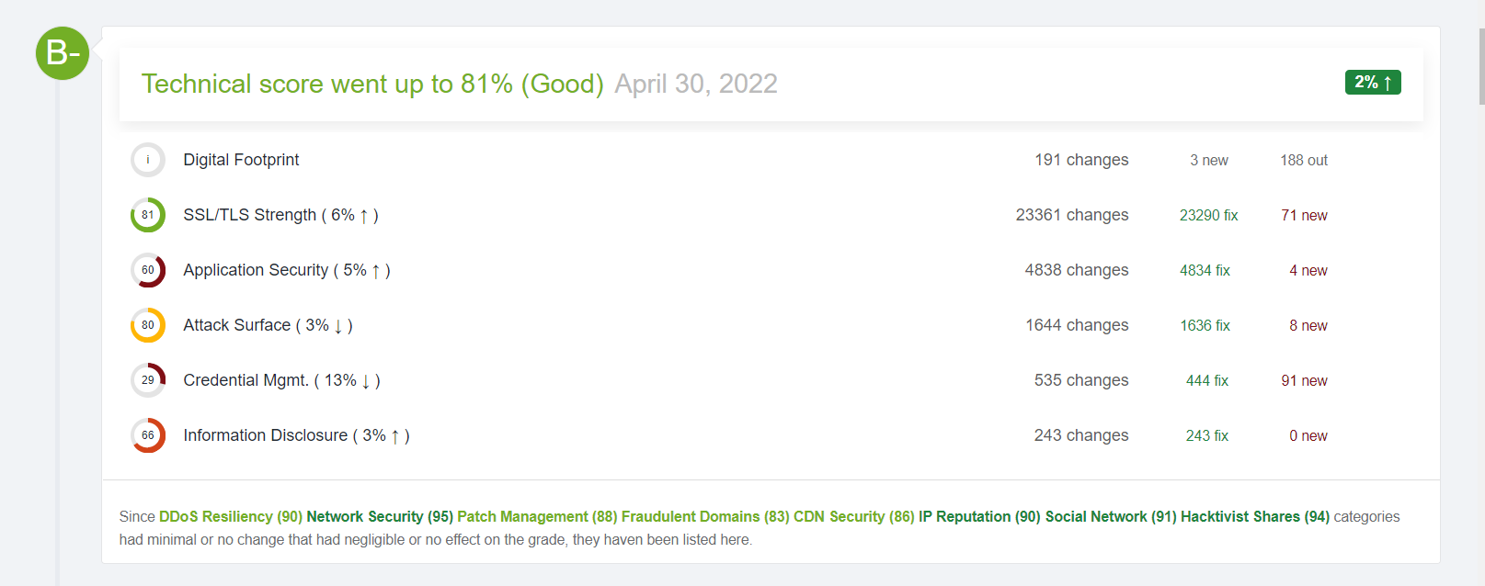
CyberVerse
Objectives of the Solution
EY's Cyber Forensics Risk Review provides a single window to help CIO/CISOs to manage information security posture of the organization and offers outside IN view over 20 modules which are mapped with NIST/ISO’s and other standard frameworks: report stating the Ransomware Susceptibility Index (RSI) and mitigation / improvement strategy.
Do it yourself with AI - ML
Risk Review & benchmark policies
Overall organization's compliance score based on multiple checklists
Ransomware Risk and Cyber Maturity Assessment
Metrics & Reporting
Insights for Board and Senior Leadership
Dashboards made of multiple reports / tools /third parties generated periodically
Incident Lifecycle Management
Strategy & Roadmap
Project Lifecycle Management
Create & manage training for teams, compliance & performance
Assistance / Creation for Handbooks, Playbooks
Acknowledge company's readiness against Cyber-attacks.
Determine if your current processes and procedures are fit-for-purpose to break the ransomware radar
Get overall and domain specific scores with improvement strategy over 20 modules
Identifying improvements strategy aligned to business
Brand monitoring and monitoring of credential leakage on Dark web, social network etc
Continuous cyber score with non-intrusive scans from outside IN view
Call for support (Forensic Investigation)
Sample Output

Slide 4
Key Differentiators
Integration to various security risks to provide a singular view for CISO/CIO dashboards
Ransomware Susceptibility Index (RSI) and Data Breach Index (DBI)
Reduce operational time by ~30%, thus more focus on leadership
Business oriented on-demand AI/ML intelligence
Benchmark and create policies based on leading industry standards
Risk based model to monitor the central compliance metrics and trends over time.
Readiness scores and gaps against ransomware attack and cyber maturity posture.
Align security objectives with company vision via tailormade vCISO platform
Heatmap and Risky assets identification on attack surface
Benchmarking against Peers and Industry average
Understanding Organisational Readiness scores and gaps and providing resilience support
Workshops with clients on detailed reports
On demand reports
Monitoring of critical alerts
Technical Components
EY's technology stack collects, analyses, and reports security-related events and results using Open-Source Intelligence services.
Connector to the client’s security systems for a centralised dashboard
Interactive dashboards with option to Drill up/Drill down
Repository of regulations (local and global) applicable for that industry
Ransomware risk, Cyber Maturity, Forensic Readiness assessment framework (questionnaire based) to identify potential gaps
Summary view for various audit checklists and the responses
Operational dashboards showing various metrics and modules
Repository of standards for reference like ISO, NIST and CSC etc
Regulatory training, compliance, and performance monitoring
AI based chat bot to provide interactive reporting

Slide 5
Thank You

